Slide 1

Optimizing the UX for CL’s sporting goods page
> Team Hello World!_

Slide 2



MEET THE TEAM!
Aaron Chen
Sriya Musunuru
Vinod Iyer
> Team Hello World!_

Slide 3
TABLE OF CONTENTS
01
03
02
04
About Craigslist
Webscraping &
pre-processing
Business Idea
Analysis & Modelling
> Team Hello World!_

Slide 4
01
About Craigslist
> Team Hello World!_

Slide 5
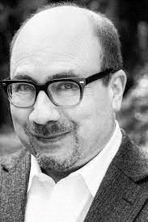
Raison d’etre
Craigslist is about helping people put food on the table, it’s about helping them find a table to put the food on, and lastly, it’s about helping people find a roof under which to put the table with the food.
> Team Hello World!_

Slide 6
60 MILLION
50 BILLION
Active users in the USA
Page views every month
50 MILLION
Queries daily
> Team Hello World!_

Slide 7
A PICTURE IS WORTH A THOUSAND WORDS
Then, why is it so far behind in user experience?
> Team Hello World!_

Slide 8
Craig Newmark
“If most people are good and their needs are simple, all you have to do to serve them well is build a minimal infrastructure allowing them to get together and work things out for themselves. Any additional features are almost certainly superfluous and could even be damaging.”
> Team Hello World!_

Slide 9
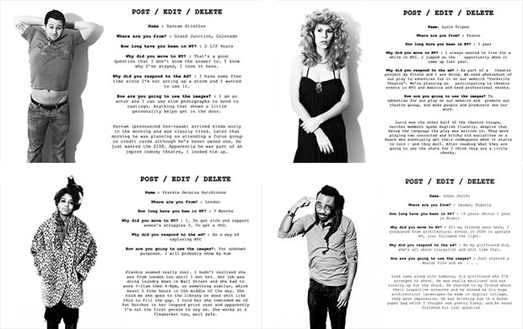
https://petapixel.com/2011/11/30/portraits-of-people-who-use-craigslist/
> Team Hello World!_

Slide 10
02
Business Idea
> Team Hello World!_

Slide 11





Classification of sporting goods
> Team Hello World!_

Slide 12




Market by numbers
Market Size
Market Share
Growth Rate
Revenue
65.1 Bn
32.5%
18.6%
14.5 Bn
> Team Hello World!_

Slide 13


Craigslist – Sporting Goods craigslist.org/d/sporting-goods/search/sga
#Listings
#Sports
#Filters
Number of ads active right now
Football, Hockey, Tennis, Gym Equipment etc.
Number of filters to search for a product
<5000
>25
01
> Team Hello World!_

Slide 14
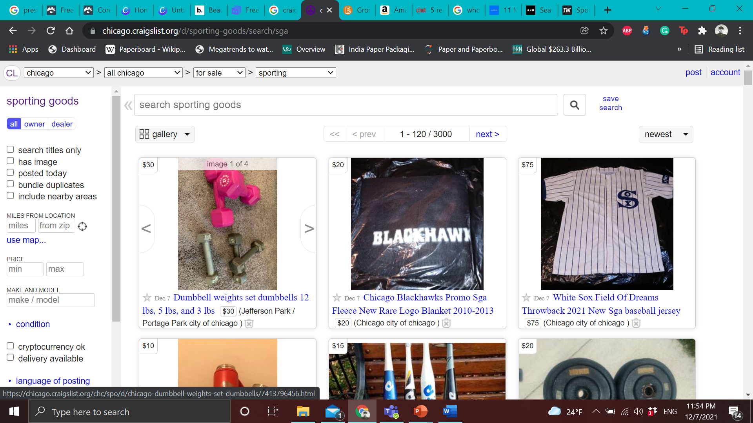
Problem Statement
Optimizing the user experience on the sports goods section of Craigslist craigslist.org/d/sporting-goods/search/sga by bucketing the listings into categories in order to better serve the end user.
> Team Hello World!_

Slide 15
03
Webscraping & preprocessing
> Team Hello World!_

Slide 16

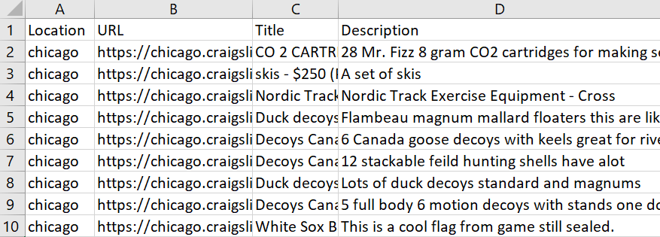
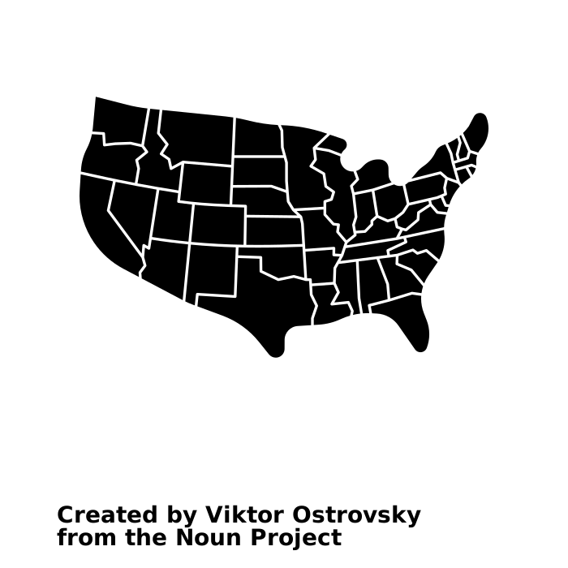


Data Input
Step 0
Listing Title
Listing Description
20 Cities
> Team Hello World!_

Slide 17



Preprocessing steps
Step 1
ā Step 2
Step 3
Step 4
Step 5
Step 6
Tokenization
Lowercasing
Stop words removal
Stemming
Lemmatization
Vectorization
> Team Hello World!_

Slide 18
LDA Topic Modelling
Topics | Key Words | Finalized Topic
Topic 0 | “surfboard” “wet suit” “fish” | Water Sports
Topic 1 | “ski” “boot” “woman” | Woman Sport Accessories
Topic 2 | “steelhead” “helmet” “size” | General Accessories
Topic 3 | “golf” “Iron” “size | Golf
Topic 4 | “snowboard” “good” condition” | Winter Sports
Topic 5 | “boots” “ski” “boy” | Men Sport Accessories
Topic 6 | “board” size” condition” | Skating
Topic 8 | “gym” “weight” “bar” | Workout Equipment
> Team Hello World!_

Slide 19










Category Tagging
Roller
Sports
Outdoor
Hunting
Baseball
Golf
Winter
Sports
Health &
Fitness
Water
Sports
Net-based Sports
Misc.
> Team Hello World!_

Slide 20
04
Analysis & Modelling
> Team Hello World!_

Slide 21
Analyzing Categories by City
Portland and Denver - winter sports is the most popular
New York and Chicago - health and fitness is the most popular
> Team Hello World!_

Slide 22

OVERVIEW DIAGRAM
Header
Nav
Models
Body
Footer
Models used
Support Vector Classifier (SVC)
Multinomial Naïve Bayes
Random Forest
Long Short-Term Memory (LSTM)
Convolution Neural Network (CNN)
> Team Hello World!_

Slide 23
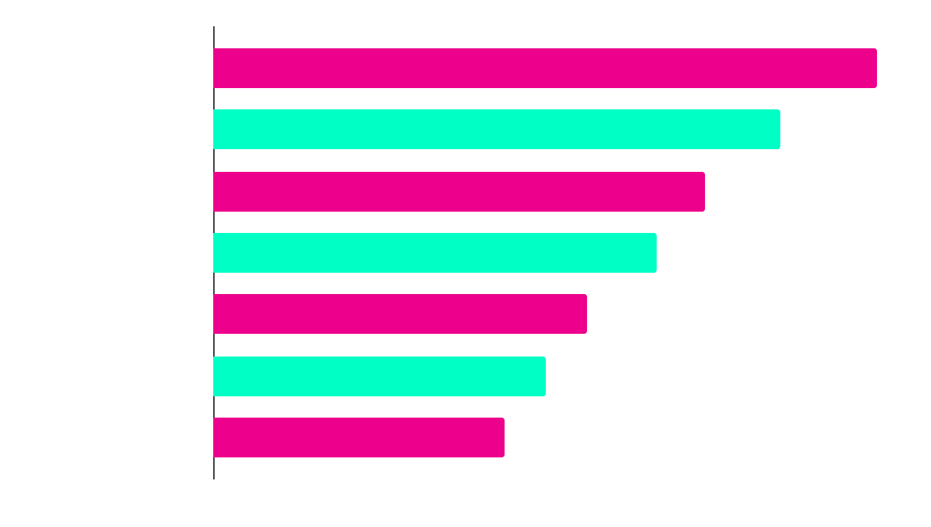
DID YOU KNOW THIS?
Model Comparison - Accuracy
Support Vector Classifier (SVC)
84.13%
Multinomial Naïve Bayes
72.10%
Random Forest
71.96%
Long Short-Term Memory (LSTM)
68.50%
Convolutional Neural Network (CNN)
68.10%
25%
50%
75%
100%
> Team Hello World!_

Slide 24
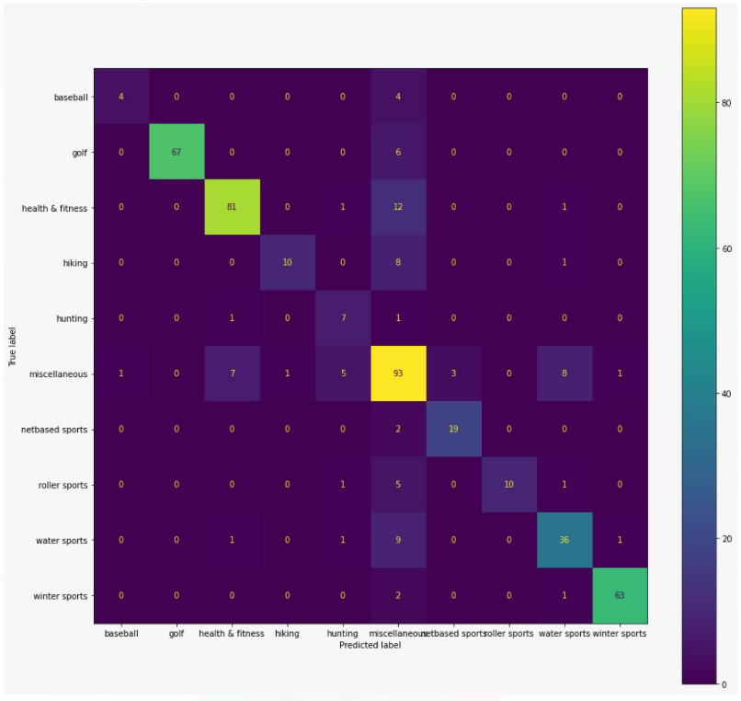
Confusion Matrix – Best Model
> Team Hello World!_

Slide 25
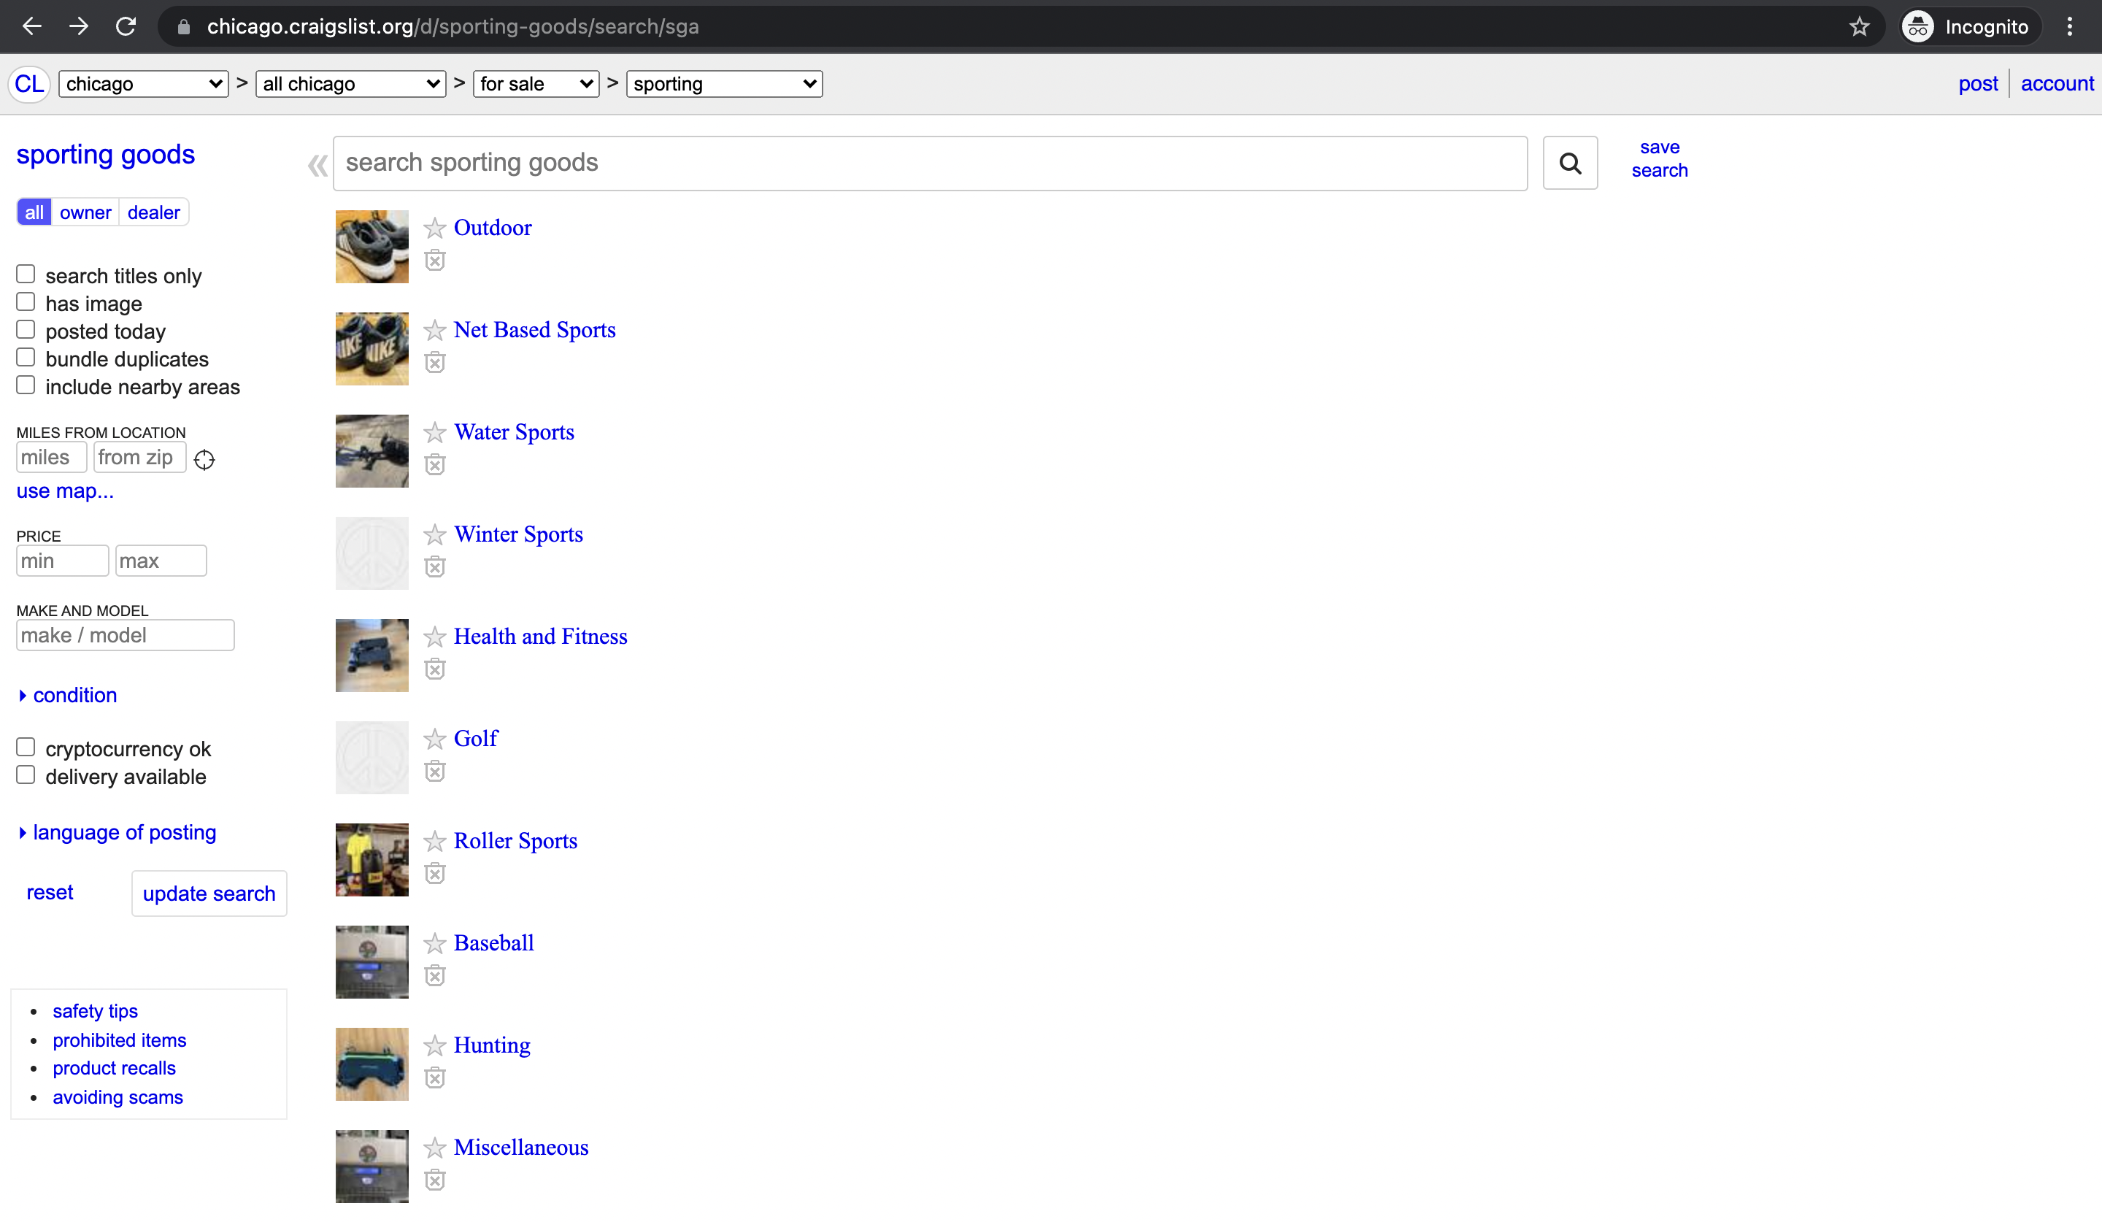




Proposed Output
WOW!!!!
> Team Hello World!_

Slide 26
Way forward
Implement an A/B Testing phase to test for significance
Given its successful, find the ideal combination of categories & subcategories for the website
Incorporate classification based on Image recognition
> Team Hello World!_

Slide 27

> Team Hello World!_

